Slide 1
Incline High School Scholarship Night 2020
June 17, 2020

Slide 2
Program
Welcome
Jennifer Jango-Cohen Lead Counselor
Patriotic Poem “Old Glory”
Cristina Cervantes Cruz ROTC Battalion Commander
Greeting, Valedictorians and National Hispanic Scholar
Dr. Andrew Yoxsimer Principal
Presentation Academic Awards
Kari Michael Assistant Principal
The Capstone Diploma
Joanne Devine Dean of Students
Presentation of Scholarships
Milton Hyams Social Studies Department Leader & Beth Gebhardt English Department
Closing Remarks
Jennifer Jango-Cohen

Slide 3
I Am Old Glory
by Master Sergeant Percy Webb, USMC
For more than ten score years I have been the banner of hope and freedom for generation after generation of Americans.
Born amid the first flames of America's fight for freedom, I am the symbol of a country that has grown from a little group of thirteen colonies to a united nation of fifty sovereign states.
Planted firmly on the high pinnacle of American Faith my gently fluttering folds have proved an inspiration to untold millions.
Men have followed me into battle with unwavering courage. They have looked upon me as a symbol of national unity. They have prayed that they and their fellow citizens might continue to enjoy the life, liberty and pursuit of happiness, which have been granted to every American as the heritage of free men.
So long as men love liberty more than life itself; so long as they treasure the priceless privileges bought with the blood of our forefathers; so long as the principles of truth, justice and charity for all remain deeply rooted in human hearts, I shall continue to be the enduring banner of the United States of America.

Slide 4
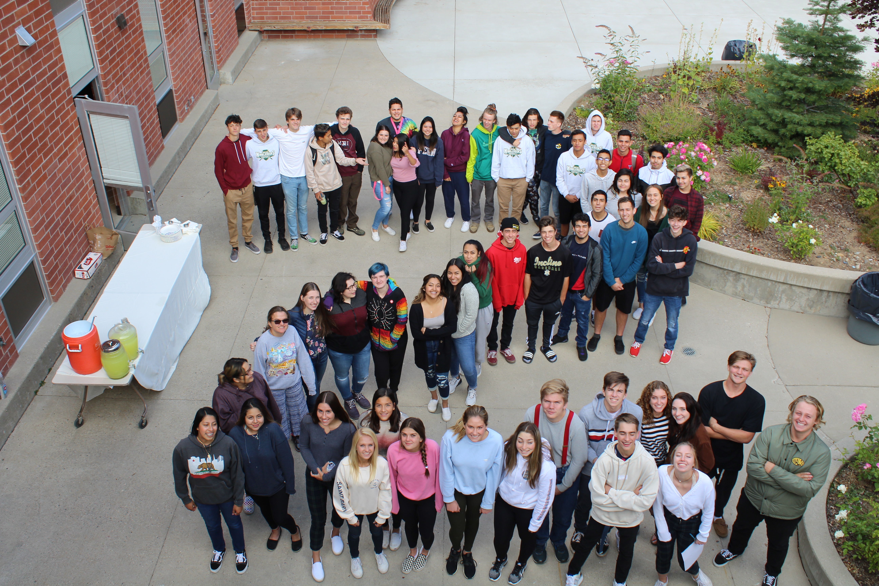
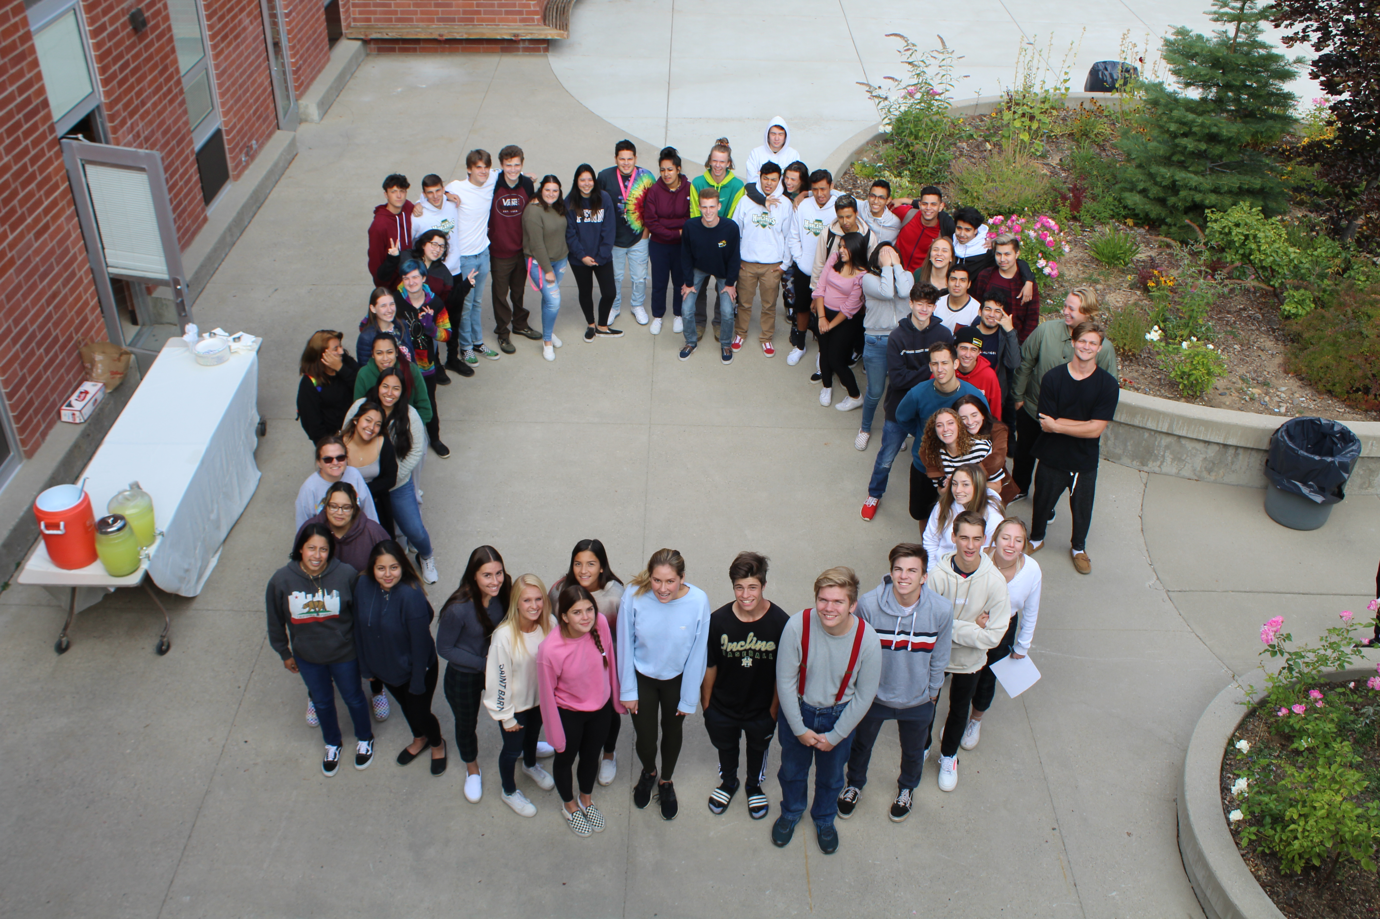
Principal, Dr. Andrew Yoxsimer

Slide 5
Class of 2020 Valedictorians
LUCY DONAHUE
EMERSON FLEMING
SAMANTHA GIANGRECO
OLIVIA SCHNEIDER
KATHERINE TONG

Slide 6
National Hispanic Scholar
SAMANTHA GIANGRECO

Slide 7
Assistant Principal, Kari Michael

Slide 8
Advanced Placement Scholars
JARET CROSS
SAMANTHA GIANGRECO
MARY JANE HATCHETT
CHLOE MENZIES
AIDEN PUGH
MICHAELA RACICH
JACQUELINE SCHWARTZ

Slide 9
Advanced Placement Scholars with Honor
FORREST DERR
LUCY DONAHUE
KATHERINE TONG

Slide 10
Advanced Placement Scholars with Distinction
CLARA ARCARIS-WEISS
GAREN CROSS
SERENA FAULKNER
EMERSON FLEMING
OLIVIA SCHNEIDER

Slide 11
Dean of Students, Joanne Devine

Slide 12
Advanced Placement Capstone Diploma Candidates
GAREN CROSS
LIBERTY HANSON
MARY JANE HATCHETT
CHLOE MENZIES
OLIVIA SCHNEIDER

Slide 13
Advanced Placement Capstone Diploma
CLARA ARCARIS-WEISS
LUCY DONAHUE
EMERSON FLEMING
KATHERINE TONG

Slide 14
Individual Awards and Scholarships with Milton Hyams and Elizabeth Gebhardt

Slide 15
Jenny Alamilla

Slide 16
Jenny Alamilla
TMCC
Nurturing
Reflective
Serene
AAUW Tahoe Nevada $1,000
Hot August Nights $1000
P.E.O. Chapter AC Incline Village $2,000
Rotary Most Improved $250
Rotary Club of Tahoe/Incline- Career Scholarship $1,000
Seal of Bi-literacy in Spanish

Slide 17
Clara Acaris-Weiss

Slide 18
Clara Acaris-Weiss
University of NV Reno
Composed
Industrious
Powerful
Tahoe Truckee Community Foundation $5,000
We The People Alumni
$1,000
UNR Scholars Scholarship $2,500
UNR State Access Grant $3,000
AP Scholar with Distinction
Capstone Diploma
Seal of Bi-literacy in Spanish

Slide 19
Jorge Cardiel

Slide 20
Jorge Cardiel
Sierra College
Trustworthy
Compassionate
Genuine
Dave and Cheryl Duffield Foundation $1000
Ferrari Memorial Foundation $1,000
The Horn Scholarship $500

Slide 21
Cristina Cervantes Cruz

Slide 22
Cristina
Cervantes Cruz
University of NV Reno
Determined
Decorated
Advocate
Dave and Cheryl Duffield Foundation $1,000
ITSA Conor Bujeaux Scholarship $1,000
P.E.O. Chapter AC Incline Village $2,000
Rotary Club of Tahoe-Incline (Service Above Self) $5,000
We the People Alumni $1,000
Seal of Bi-literacy in Spanish

Slide 23
Madison Corneil

Slide 24
Madison Corneil
Cal Poly San Luis Obispo
Prodigious
Caring
Dependable
AAUW Tahoe Nevada Scholarship $3,000 renewable
Clifford and Iljosa Dobler $2,000
Hanni B. Memorial Scholarship $1,000
Hyatt Regency $750

Slide 25
Garen Cross

Slide 26
Garen Cross
Dickinson University
Adventurous
Resilient
Polyglot
Incline Village Realtors $1000
U.S. Army ROTC Scholarship $274,720
AP Capstone Diploma Candidate
AP Scholar with Distinction
Seal of Bi-literacy in Spanish, French, Russian
STEM/STEAM Diploma

Slide 27
Jaret Cross

Slide 28
Jaret Cross
University of Utah
Clever
Accepting
Self-Assured
Dave and Cheryl Duffield Foundation $1,000
AP Scholar
Seal of Bi-literacy in Spanish and French
STEM/STEAM Diploma

Slide 29
Forrest Derr

Slide 30
Forrest Derr
Willamette University
Altruistic
Charismatic
Outstanding
Dave and Cheryl Duffield Foundation $1,000
G.K Hardt $1000
Incline Village Realtors $1000
We the People Alumni $2,000
Willamette University Trustee’s Scholarship and Grant $41,000
AP Scholar with Honor
STEM/STEAM Diploma

Slide 31
Lucy Donahue

Slide 32
Lucy Donahue
Washington and Lee University
Independent
Persuasive
Scholarly
Clifford and Iljosa Dobler $2,000
Hyatt Regency $750
The Jacquie Foundation Scholarship $5,000
We the People Alumni $1,000
Questbridge Scholarship for Washington and Lee University $314,800
AP Captone Diploma
AP Scholar with Honor
Seal of Bi-literacy in Spanish
STEM/STEAM Diploma
Valedictorian

Slide 33
Anna Erickson

Slide 34
Anna Erickson
Cal Poly San Luis Obispo
Collaborative
Illuminated
Positive
AAUW Tahoe Nevada $1,000
Dave and Cheryl Duffield Foundation $1000

Slide 35
Emerson Fleming

Slide 36
Emerson Fleming
University of NV Reno
Endearing
Humble
Versatile
Clifford and Iljosa Dobler $2,000
Hyatt Regency $750
Rotary Club of Tahoe-Incline (High Achiever) $5,0000
Washoe Education Association $50
We the People Alumni $1,000
University of Nevada Reno Presidential Scholarship
$32,000
AP Capstone Diploma
AP Scholar with Distinction
Seal of Bi-literacy in Spanish
STEM/STEAM Diploma
Valedictorian

Slide 37
Samantha Giangreco

Slide 38
Samantha Giangreco
Cal Poly San Luis Obispo
Accomplished
Dynamic
Unifying
Clifford and Iljosa Dobler $2,000
Dave and Cheryl Duffield Foundation $1,000
AP Scholar
National Hispanic Scholar
STEM/STEAM Diploma
Valedictorian

Slide 39
Liberty Hanson

Slide 40
Liberty Hanson
College for Creative Studies
Free-Spirited
Poised
Problem-Solver
Maryanne Ingemanson Award Republican Women of Crystal Bay and Incline Village $2,000
Robert Z. Hawkins $1000
We the People Alumni $1,000
College for Creative Studies University Scholarship $31,300
AP Capstone Diploma Candidate

Slide 41
Jacob Harrell

Slide 42
Jacob Harrell
University of Colorado at Boulder
Sharp
Outgoing
Revolutionary
Clifford and Iljosa Dobler $2,000
We the People Alumni $1,000
STEM/STEAM Diploma

Slide 43
Angelica Herrera

Slide 44
Angelica Herrera
University of NV Reno
Diligent
Considerate
Radiant
AAUW Tahoe Nevada $1,000
Clifford and Iljosa Dobler $2,000
Dave and Cheryl Duffield Foundation $1,000
P.E.O Chapter AC Incline Village $2,000
Next Steps- Pay It Forward $1,200
Tahoe Forest Hospital District Medical Staff $1,000
Seal of Bi-literacy in Spanish

Slide 45
Brayden Hock

Slide 46
Brayden Hock
Boise State University
Curious
Ebullient
Grateful
North Lake Tahoe Hospital Women's Auxiliary $6,000
Rotary Most Improved $250

Slide 47
Tyler Knight

Slide 48
Tyler Knight
University of the Pacific
Athletic
Persevering
Meritable
Maryanne Ingemanson Award- Republican Women of Crystal Bay and Incline Village $2,000
University of the Pacific University Grant $21,200

Slide 49
Chloe Menzies

Slide 50
Chloe Menzies
Wake Forest University
Graceful
Effervescent
Activist
Classical Tahoe Music Institute $500
Tahoe Truckee Community Foundation Scholarship $5,000
We the People Alumni $1,000
AP Capstone Diploma Candidate
AP Scholar
Seal of Bi-literacy in Spanish
STEM/STEAM Diploma

Slide 51
Kaci Meyer

Slide 52
Kaci Meyer
University of NV Reno
Hardworking
Disciplined
Talented
E.M. Laird Scholarship $1,200
P.E.O Chapter AC Incline Village $2,000
Tahoe Truckee Community Foundation Scholarship $5,000
Seal of Bi-literacy in Spanish and French

Slide 53
Nika Ogden

Slide 54
Nika Ogden
Biola University
Introspective
Expressive
Responsible
AAUW Tahoe Nevada $3,000 renewable
Best Buddies Incline $2,000
North Lake Tahoe Hospital Women’s Auxiliary $6000
Biola Dean’s Academic Scholarship $18,000
Seal of Bi-literacy in Spanish

Slide 55
Michaela Racich

Slide 56
Michaela Racich
Texas Christian University
Captivating
Gregarious
Thorough
Incline Village Realtors $1000
Texas Christian University Grant $64,000
AP Scholar

Slide 57
Olivia Schneider

Slide 58
Olivia Schneider
University of Miami
Compassionate
Honorable
Humanitarian
Dave and Cheryl Duffield Foundation $1000
We the People Alumni $1,000
University of Miami Presidential Scholarship $92,000
AP Capstone Diploma Candidate
AP Scholar with Distinction
Valedictorian

Slide 59
Brenna Soli

Slide 60
Brenna Soli
San Diego State
University
Impassioned
Thoughtful
Organized
Dave and Cheryl Duffield Foundation $1,000
Incline Village Nursery School $500
KDL Life Long Learning Scholarship $500

Slide 61
Katherine Tong

Slide 62
Katherine Tong
American University
Observant
Logical
Pragmatic
Dave and Cheryl Duffield Foundation $1000
We the People Alumni $1,000
American University
Dean’s Scholarship
$52,000
AP Capstone Diploma
AP Scholar with Honor
STEM/STEAM Diploma
Valedictorian

Slide 63
Carolina Vargas

Slide 64
Carolina Vargas
University of NV Reno
Confident
Communicative
Courageous
Next Steps- Pay It Forward $1,200
North Lake Tahoe Hospital Women's Auxiliary $3,000
P.E.O Chapter AC Incline Village $2,000
Seal of Bi-literacy in Spanish

Slide 65
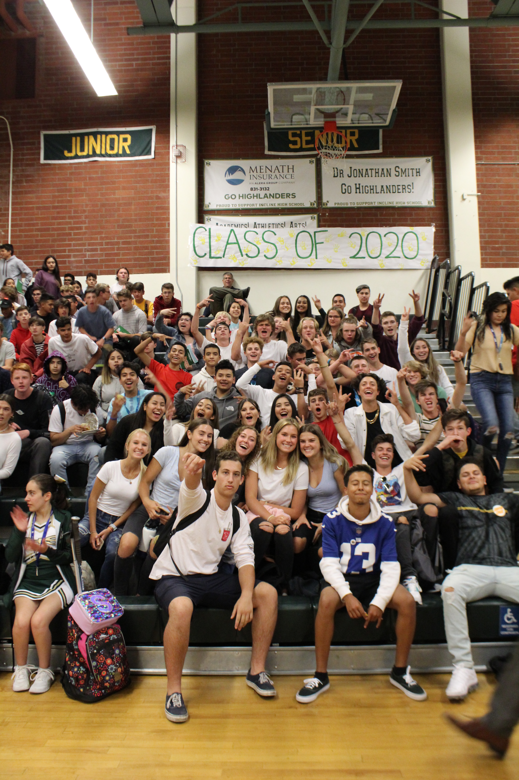
Congratulations Class of 2020!

Slide 66
Thank You To Our Wonderful Sponsors!
AAUW – TAHOE NEVADA
ANONYMOUS-NEXT STEP
BILL HORN
CLASSICAL TAHOE MUSIC INSTITUTE
CLIFFORD AND ILJOSA DOBLER
CONOR BUJEAUX
CRYSTAL BAY/ INCLINE VILLAGE REPUBLICAN WOMEN
DAVE AND CHERYL DUFFIELD SCHOLARSHIP FOUNDATION
E.M. LAIRD MEMORIAL
FERRARI FAMILY FOUNDATION
G.K. HARDT MEMORIAL
HANNI B. MEMORIAL SCHOLARSHIP
HOT AUGUST NIGHTS FOUNDATION
HYATT REGENCY LAKE TAHOE
INCLINE VILLAGE NURSERY SCHOOL
INCLINE VILLAGE REALTORS
THE JACQUIE FOUNDATION
KDL LLC LIFELONG LEARNING
NORTH LAKE TAHOE COMMUNITY HEALTH CARE AUXILIARY
P.E.O. CHAPTER AC LOCAL, INCLINE VILLAGE
ROBERT Z. HAWKINS FOUNDATION
ROTARY CLUB OF INCLINE VILLAGE
SAVITT FAMILY
SCHAFER FAMILY- BEST BUDDIES INCLINE SCHOLARSHIP
TAHOE FOREST HOSPITAL DISTRICT MEDICAL STAFF
TAHOE-INCLINE ROTARY
WASHOE EDUCATION ASSOCIATION
WE THE PEOPLE ALUMNI

